Slide 1

A
Castor Solutions
Presentation

Slide 2
Introducing a Product That
Is Lightweight
Is Innovative
Is Revolutionary
Is Thoughtful
Is Simple
Redefines HR Software

Slide 3

Castor Human Resource Software for
Simple Sales Centre
Harmony Of Functionality & Simplicity.

Slide 4

Who are we?
We are…
Committed to bringing out only the very best of software products
Among the fastest-growing and most innovative small companies in Canada
A team of 4 young, hardworking and talented entrepreneurs based in Toronto
Castor Business Solutions|

Slide 5

Castor Solutions Motto & Values
Making a Difference for Small Enterprises.
Innovation
Simplicity
Value
Commitment
Teamwork
Castor Business Solutions|

Slide 6
What Stands Out About Our Program
Intuitive Graphic Interface
Accurate, User-Friendly
Custom-Tailored to Meet & Exceed Expectations
Flexibly Designed to Accommodate Growth
Castor Business Solutions|

Slide 7
Program Main Functions
Add, edit, view and delete employee info
Employee payroll & bonuses calculation based on salary or wage
Absence, sick and vacation days tracking
Sorting based on employee names
All-inclusive search function that prioritizes most relevant results first
Uses database fields to hold information
Castor Business Solutions|

Slide 8
Choosing the Right HR Software Can…
Help Streamline Interdepartmental Processes & Achieve High Return on Investment
Track Employee Information Effortlessly
Accommodate Company Growth Adequately
Help you Save Money in the Long Run

Slide 9
Live Program Demonstration
Begins Here

Slide 10
Thank You!
Castor Toronto Headquarters: 580 Yonge Street, M2R 3L8  416 358 6298  www.castorSolutions.com

Slide 11
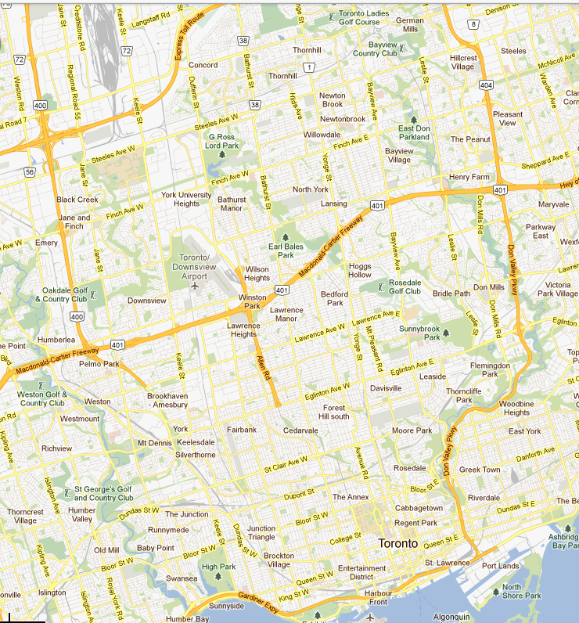
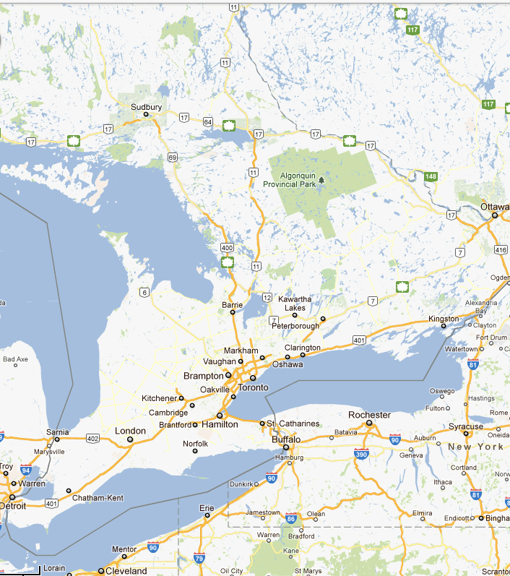

Our Target Market
- Geographic Factor
Main Focus:
Greater Toronto Area Urban Core and Southeastern Ontario
Private Transportation Arranged to Toronto Pearson International Airport
Proudly Canadian
Business with Asiana Tours |

Slide 12

Our Target Market
- Psychographic Factors
Adventurous, Willing to Explore New Sights & Sounds
Strong Desire to Escape Canada/North America for a while
Adults who lack foreign travel experience, and want to experience a new travel lifestyle
Young Couples who desire an unforgettable honeymoon together
Business with Asiana Tours |

Slide 13




Reaching Our Target Market
(Our Advertising/Marketing Campaign)
Establish Advertising Partnership with the following major GTA media organizations:
Create unique online experiences at www.asianatours.com and on Asiana Tours Tumblr blog, and encourage continuous viewership from potential customers
Attract local Asian travelers through Asian-language newspapers and online websites
Display our daily and weekly package deals and offers through online advertising
MLSE
(Toronto Maple Leafs, Toronto Raptors, Toronto FC, Toronto Marlies)
Toronto Star
CBC
Metro News
Business with Asiana Tours |

Slide 14
s
Our Competitive Edges
fffff
We offer unbeatable, high satisfaction reservation services online, in-person, and over-the-phone
No major Canadian travel companies offer such wide variety of Asian travel destinations like we do
We offer much lower prices on travel to Asia relative to other Canadian companies
We offer customized vacation plans based on customer budget and personal requirements
We take advantage of the growing demand of people wanting to travel beyond America, Mexico , Europe and the Caribbean's
We are a small and efficient small company; Low running cost results in higher profitability
Business with Asiana Tours |

Slide 15
Your Investment Helps…
Build our influence within the Canadian travel market
Distinguish our brand through greater advertising investments
Expand our company into other regions of Canada and fund new offices and employees
Asiana Tours become the largest travel agency in North America dedicated to Asian destinations
Business with Asiana Tours |

